Slide 1
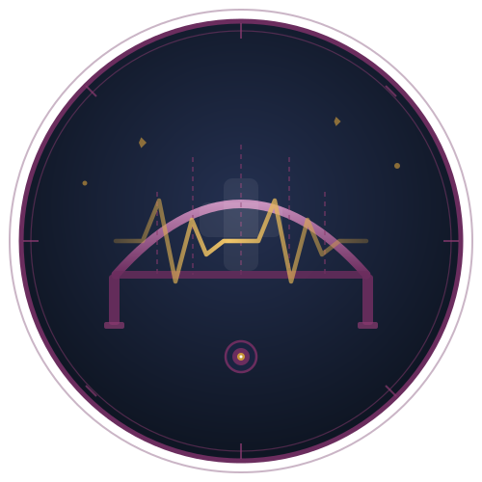
HEALTHBRIDGE MEDICAL
HealthBridge AI
Patient Support Chatbot
A RAG-Powered Generative AI Solution
Capstone Project — Generative AI with RAG
Confidential | Generative AI Capstone | 2026

Slide 2

REAL-WORLD GENERATIVE AI USE CASE
Company: HealthBridge Medical Group
Clara — Patient Chatbot
You
HealthBridge AI — "Clara"
When is my next appointment?
An intelligent patient-support chatbot integrated into HealthBridge's patient portal and mobile app. Clara leverages Retrieval-Augmented Generation (RAG) to provide patients with accurate, real-time answers about their care, medications, appointments, and health policies.
Clara
Your next visit: Tuesday Apr 15 at 2PM, Dr. Nguyen.
You
Can I reschedule?
Appointment & scheduling queries
Medication info & reminders
Clara
Of course! I can help you find an open slot.
Post-visit care instructions
Insurance & billing FAQs
HealthBridge AI | Capstone 2026

Slide 3
BUSINESS PROBLEM
HealthBridge Medical faces a critical patient engagement crisis
68%
12 min
31%
$2.4M
of patients report difficulty
reaching support staff
average hold time for
non-urgent inquiries
of appointments missed
due to communication gaps
annual cost of inbound
patient support calls
Key Pain Points
Patient Wait Time (min)
No 24/7 self-service option for patients with non-urgent questions
Staff overwhelmed with repetitive inquiries — medication instructions, billing, hours
Post-discharge care instructions hard to access, increasing readmissions
Patient satisfaction scores (HCAHPS) declining year-over-year
HealthBridge AI | Capstone 2026

Slide 4
AI SOLUTION — RAG-BASED CHATBOT
How Clara Uses RAG
1
2
3
4
Patient Query
Retrieval
Augmentation
Generation
Patient types a question in the portal or app
RAG searches EHR data, policy docs & web APIs
Retrieved context is injected into the LLM prompt
Claude/GPT generates a grounded, accurate answer
Key Technical Features
External data retrieval — EHR records, policy PDFs, live web search via API
Semantic vector search — Pinecone vector DB for fast, relevant retrieval
Context-aware responses — Conversation history maintained per session
HIPAA-compliant pipeline — PHI encrypted, audit logging, role-based access
HealthBridge AI | Capstone 2026

Slide 5
PRODUCT INTEGRATION
Where Clara Lives in the HealthBridge Ecosystem
Patient Portal (Web)
Mobile App (iOS/Android)
Embedded chat widget on MyHealthBridge.com — accessible post-login with full EHR context.
Native SDK integration in HealthBridge mobile app. Push notifications + in-app chat.
After-Visit Summary Emails
Nurse Triage Handoff
Clara generates and personalizes post-visit instructions triggered by EHR discharge events.
Escalation path: Clara flags urgent queries to on-call nursing staff via secure message.
Tech Stack: React / React Native | FastAPI Backend | Pinecone Vector DB | OpenAI / Anthropic LLM | AWS HIPAA-Eligible Services
HealthBridge AI | Capstone 2026

Slide 6
VALUE ADD
Measurable Impact of Clara
60%↓
24/7
4.5★
$1.4M
Reduction in
call center volume
Patient support
availability
Projected HCAHPS
satisfaction score
Estimated annual
cost savings
Strategic Benefits
Projected Call Volume Reduction
Eliminates repetitive staff workload — freeing nurses for clinical tasks
Improves care continuity with 24/7 post-discharge instruction access
Reduces preventable readmissions through medication compliance support
Scales to 10,000+ concurrent patient interactions at marginal cost
HealthBridge AI | Capstone 2026

Slide 7
DATA DETAILS
Data Sources
Data Quality
▸ Epic EHR API — patient records, appointments, meds
▸ EHR data: FHIR R4 structured, high reliability
▸ Internal policy PDFs — clinical guidelines, billing FAQs
▸ Policy docs: reviewed quarterly by compliance team
▸ MedlinePlus & FDA APIs — drug info, contraindications
▸ External APIs: reputable gov/medical sources only
▸ Real-time web search — health policy updates
▸ Web search: filtered by domain whitelist
Preprocessing
Data Storage
▸ Text extraction from PDF/DOCX documents
▸ Vector embeddings → Pinecone (AWS us-east-1, HIPAA)
▸ PHI anonymization for non-personalized queries
▸ Patient session context → Redis (encrypted, TTL 30 min)
▸ Chunking (512 tokens) + overlap for vector embedding
▸ Source documents → AWS S3 with server-side encryption
▸ Metadata tagging: source, date, sensitivity level
▸ Audit logs → AWS CloudWatch (90-day retention)
HealthBridge AI | Capstone 2026

Slide 8
VALIDATION & ACCURACY DEMONSTRATION
Guardrails & Safety Controls
Accuracy Validation Methods
HIPAA Content Filter
Blocks responses containing unverified PHI
01
A/B Accuracy Testing
500-question benchmark test comparing Clara responses against verified clinical staff answers. Target: ≥92% accuracy.
Medical Accuracy Check
Drug dosage answers verified against FDA API in real-time
02
Source Citation Audit
Hallucination Guard
Answers lacking source citations are flagged/withheld
Every response must cite a retrieved source. 100% cite-rate enforced — uncited responses are auto-suppressed.
Escalation Trigger
Detects urgency keywords → routes to on-call staff
03
User Feedback Loop
Out-of-Scope Detection
Redirects non-medical queries gracefully
Thumbs up/down per response. Low-rated answers trigger weekly human review and vector DB update.
04
Monthly Red-Team Review
Clinical team submits adversarial edge-case questions monthly; failures feed retraining pipeline.
HealthBridge AI | Capstone 2026

Slide 9
Thank You
HealthBridge AI — Clara Chatbot
✓ RAG-powered chatbot delivering 24/7 accurate patient support
✓ Integrated with EHR, policy docs, and live medical APIs
✓ HIPAA-compliant architecture with full audit trail
✓ Validated by clinical red-team + automated accuracy checks
Questions & Discussion

